Slide 1
SEE through your EARS
June ‘23
Presented by: RATS (Group 14)

Slide 2
TABLE OF CONTENTS
01
04
02
05
03
Business Objective
Product Results
Understanding Data
What’s next?
Analytics Approach

Slide 3
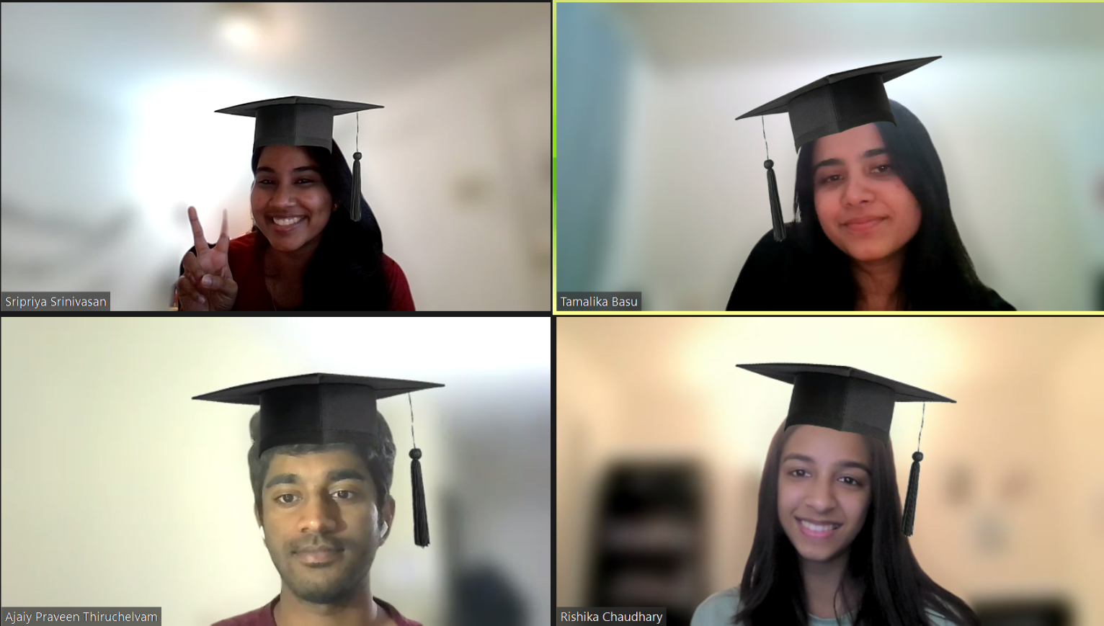
Meet the RATS

Slide 4
01
BUSINESS OBJECTIVE
To enhance the inclusivity and independence of people with visual disabilities by providing a product that converts visuals into real-time audio for a descriptive sense of their surroundings.
Our prototype aims to allow them to navigate and engage with their surroundings, make informed decisions, and participate more actively in various activities, including education, employment, and social interactions.
“W.H.O says, 40-50 million of the world population is blind!”
Notes:
Tamalika

Slide 5
Understand the Data
02
We have used the COCO (Common Objects in Context) image captioning dataset which is a widely used dataset in the field of computer vision and natural language processing.
Entire Dataset Size:
25.7 GB
Training Dataset Size:
118,287
Test Dataset Size:
40,670
Validation Dataset Size:
5,000

Slide 6
Understand the Data (1 of 3) : Caption Pre Processing
02
1
2
3
4
Input raw captions
Convert to lowercase
Remove special characters
Add special tokens for [start] and [end]
Note: The vocabulary of words created has a dictionary size 15,000 words and maximum caption length of 40.

Slide 7
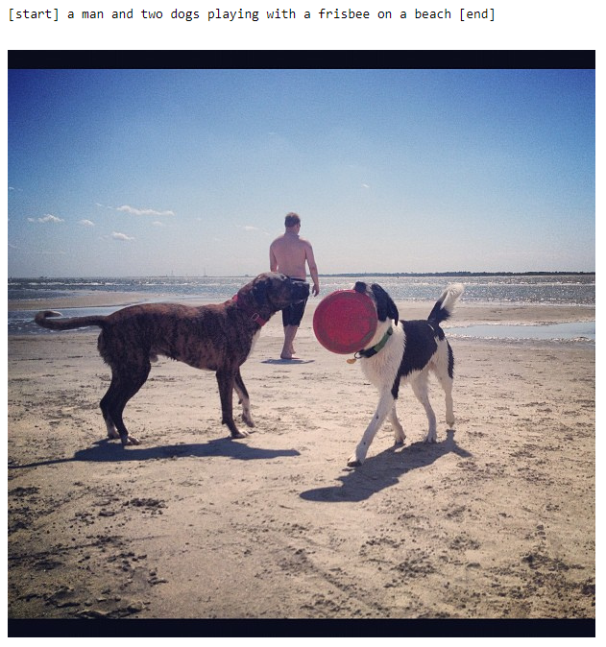
Understand the Data (2 of 3) : Example of train data
02

Slide 8
Understand the Data (3 of 3) : Image Pre Processing
02
1
2
3
4
Input raw image
Image as read as binary string
RGB encoding of
Image in JPG
format
All images resized to 299 x 299 & Image Augmentation
Note: The images are scaled and normalized before being consumed by the model

Slide 9
Analytics Approach (1 of 2): Image Caption Generator
03
Pre-
processed
Data
1
2
3
Inceptionv3 (CNN):
Extracts features from input image
Encoder:
Encodes features extracted
Decoder:
Converts encoded features to captions.

Slide 10
Analytics Approach (2 of 2): Text-to-Speech Converter
03
GTTS (Google Text-to-Speech) is a Python library tool that enables text-to-speech conversion using the Google Text-to-Speech API.
The library utilizes the power of Google's infrastructure to generate audio files (mp3) from the predicted captions using a simple and straightforward interface.
It has various attributes like Lang to choose the type of language and Slow to decide the the speed of the speech.

Slide 11
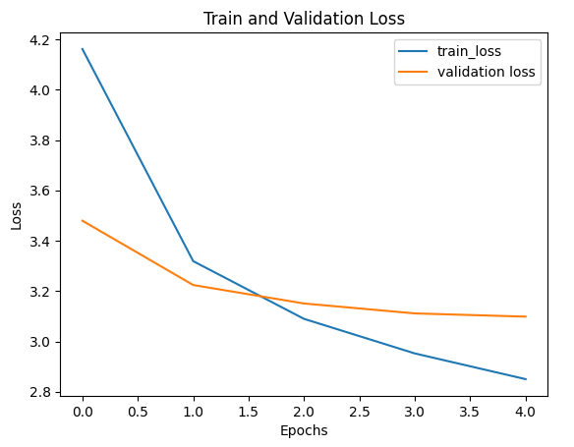
Product Results (1 of 4)
Train and Validation Data
04
Test Data
42.7 % | Model Accuracy
3. 091% | Model loss entropy (cross entropy)

Slide 12
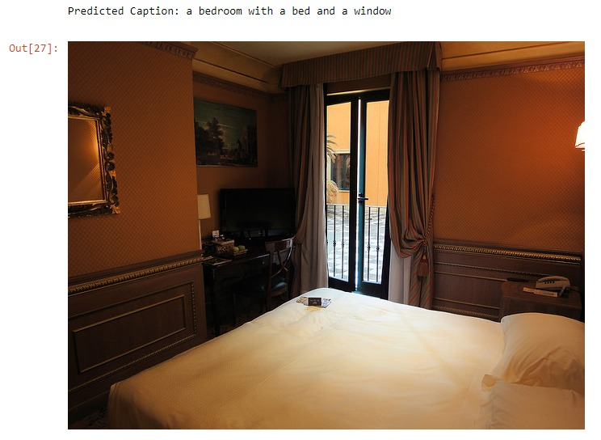

Product Results (2 of 4)
04
Caption Generator:
A bedroom with a bed and a window

Slide 13
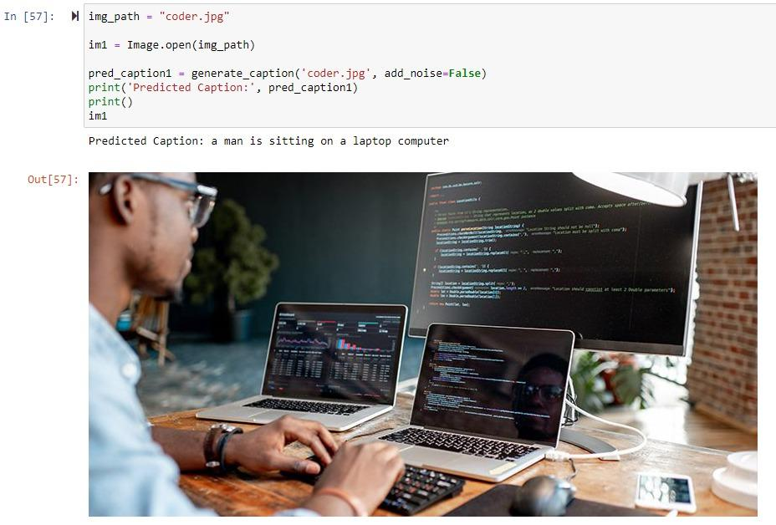
Product Results (3 of 4)
04
Caption Generator:
A man sitting on a laptop computer

Slide 14
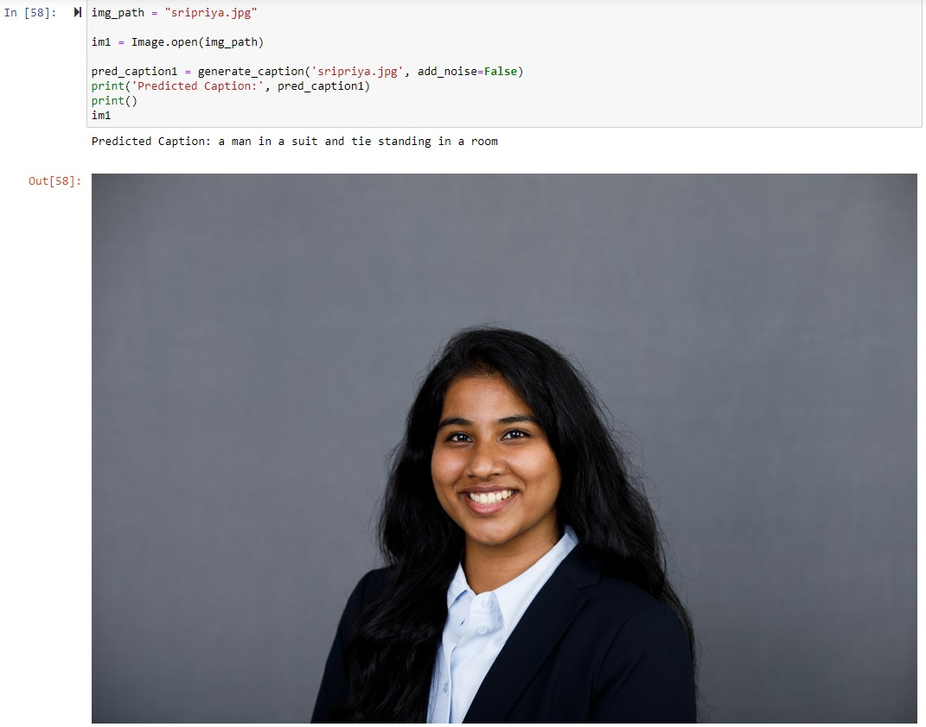
Product Results (4 of 4)
04
Caption Generator:
A man in a suit and tie standing in a room

Slide 15
What’s Next ?
05
01
Human Input Dataset
By incorporating real-life audios and descriptions from the target user group, the model can learn to generate more relevant and useful image and audio descriptions.
02
More training data allows the model to learn from a wider range of examples, improving its ability to accurately describe various visual scenes.
Increasing Training Data
03
Gathering feedback on the user experience, ease of use, and effectiveness of the audio descriptions can help identify areas for improvement and guide iterative development.
Usability Testing and Iterative
Development

Slide 16
THANK YOU!
Q/A?

Slide 17
APPENDIX
Dataset:
https://arxiv.org/abs/1405.0312
https://cocodataset.org/#home
Image Captioning:
https://paperswithcode.com/dataset/coco-captions
https://www.ijitee.org/wp-content/uploads/papers/v10i3/C83830110321.pdf
https://towardsdatascience.com/image-captioning-in-deep-learning-9cd23fb4d8d2
Speech-to-Text Conversion:
https://gtts.readthedocs.io/en/latest/

